Slide 1
Knowledge Distillation for echocardiogram View classification
Andris Freimanis Moritz Sprenger Raouf Bahsoun Yu-Ping Hsu
Supervisors: Yinan Yu Charlotte von Numers Luis Arevalo
2023-11-07

Slide 2
Introduction
The heart and its main functions
Left and right parts prevent blood mixing
Ejection fraction and its normal range (55%—65%)
Ejection fraction methods
Knowledge distillation for echocardiogram view classification

Slide 3
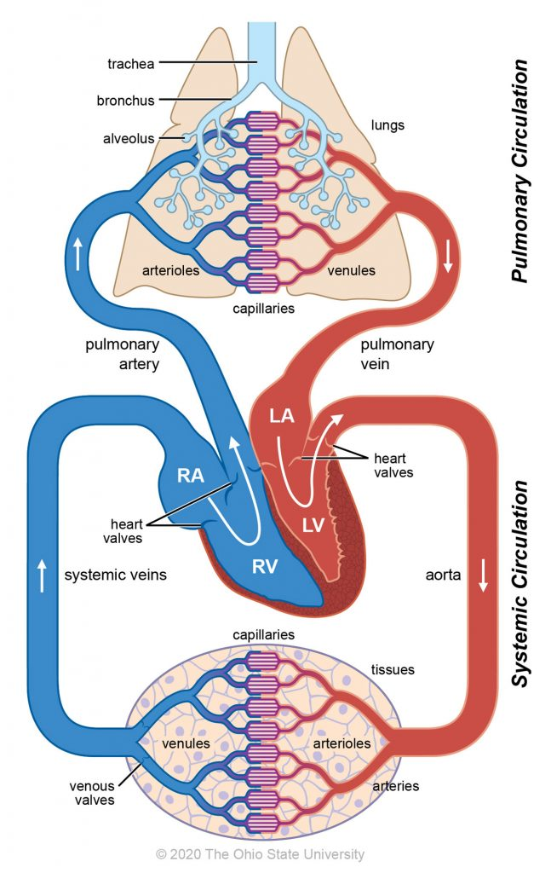
Blood circulation
Source: https://ohiostate.pressbooks.pub/vethisto/chapter/6-blood-circulation/

Slide 4
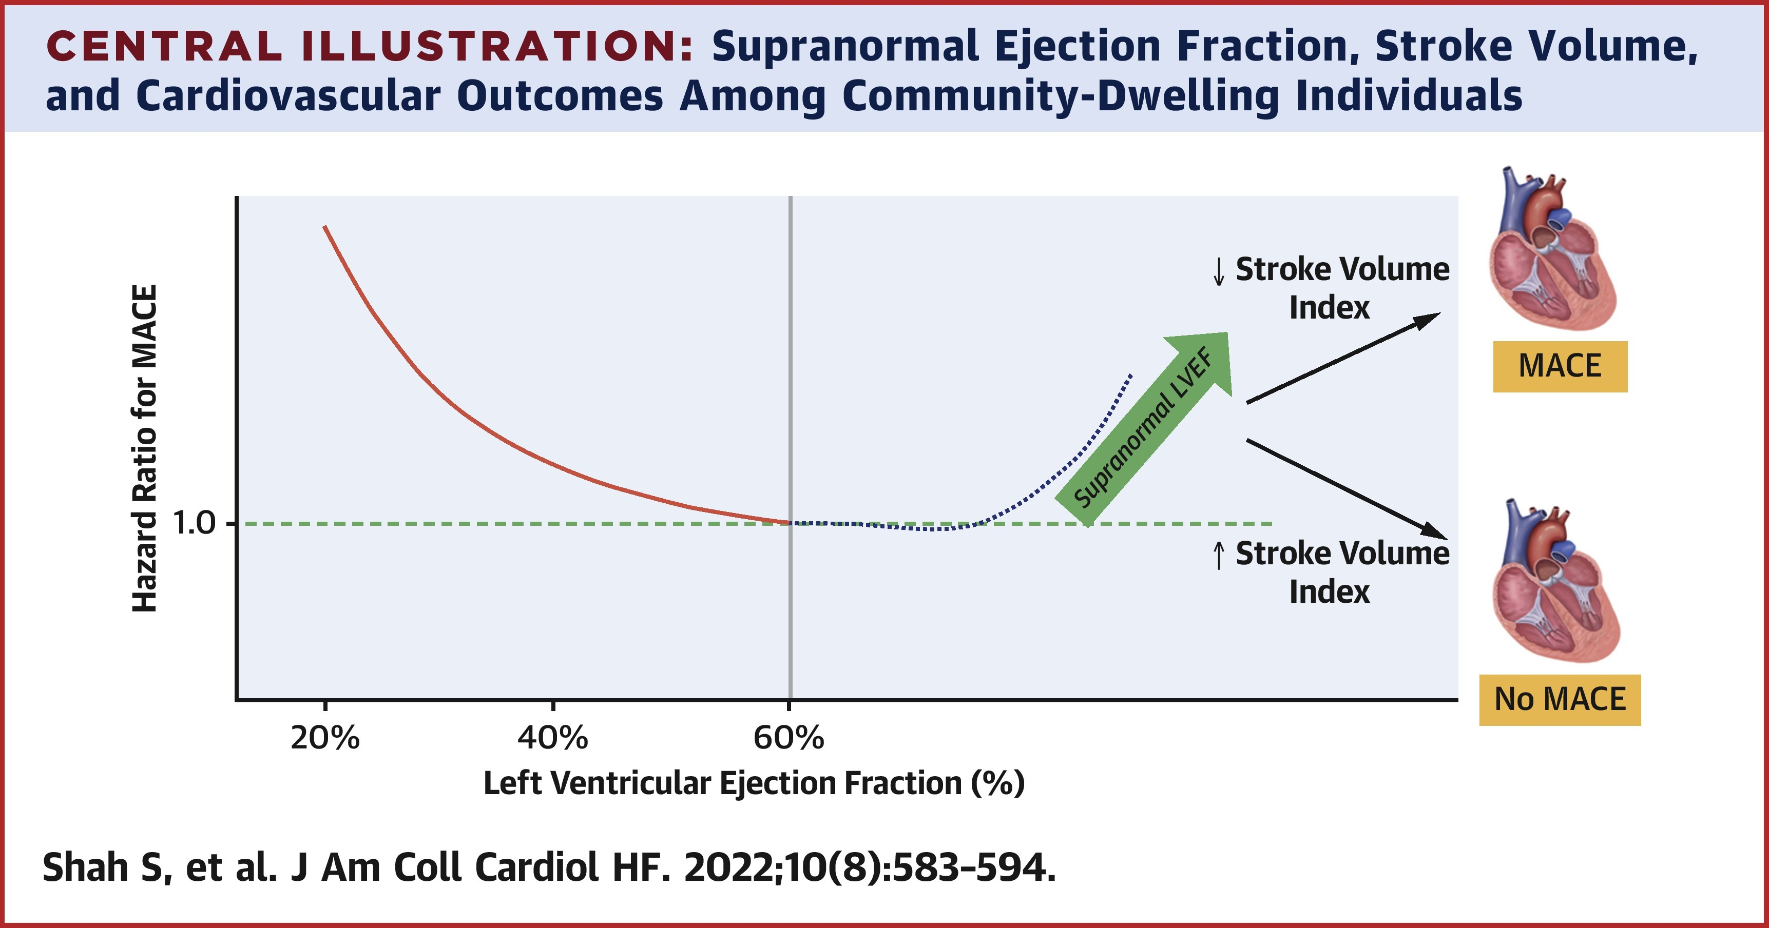
MACE = Major Adverse Cardiovascular Events
Ejection fraction is the percentage of blood pumped out of the heart each time it beats.

Slide 5
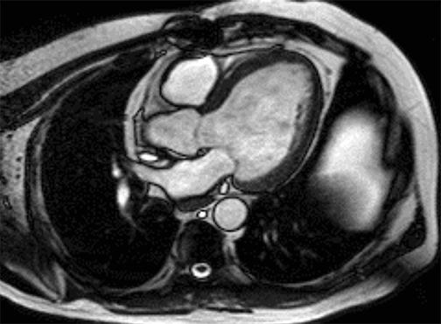
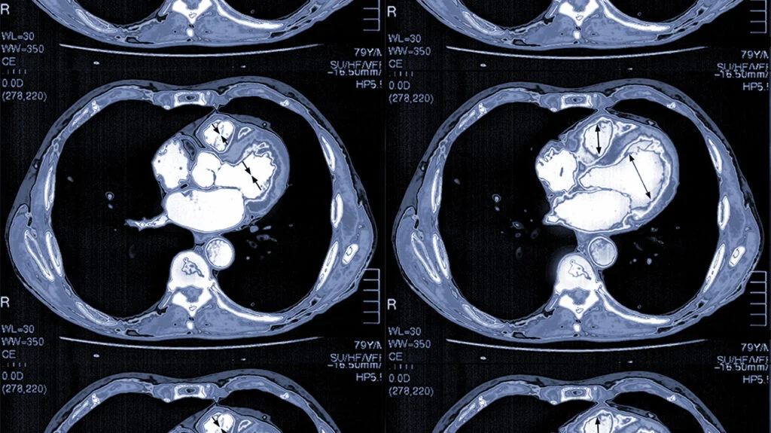
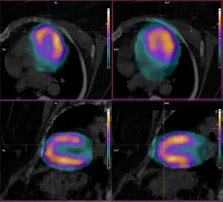
cardiac scan
MRI
CT
SPEC/CT
Source:
MRI - https://www.mclaren.org/main/blog/new-technology-sees-detailed-anatomy-of-the-heart-1271
CT - https://www.medicalnewstoday.com/articles/heart-ct-scan
SPEC/CT - https://psma-pet.radiologische-allianz.de/en/method/scintigraphy-of-the-heart/

Slide 6
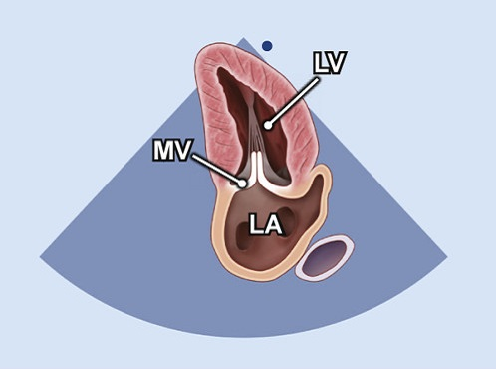
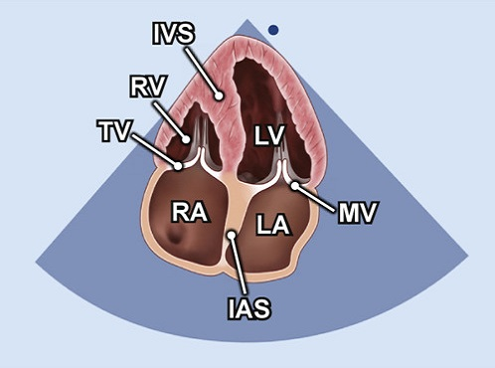
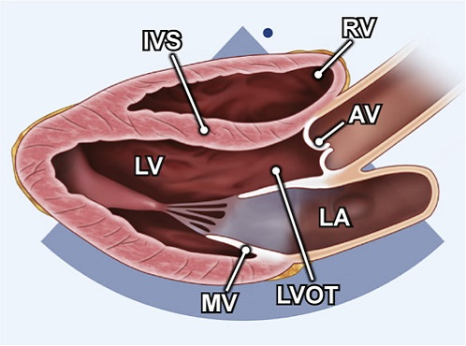
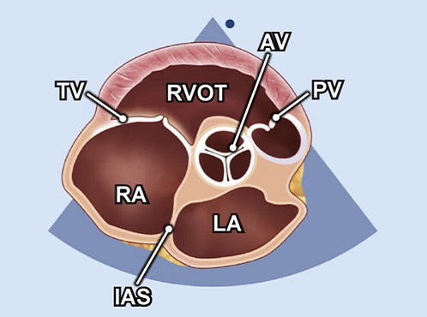
cardiac scan- ECHOCARDIOGRAM
A2C
A4C
PLAX
PSAX
Source: https://www.techmed.sk/en/echo/

Slide 7
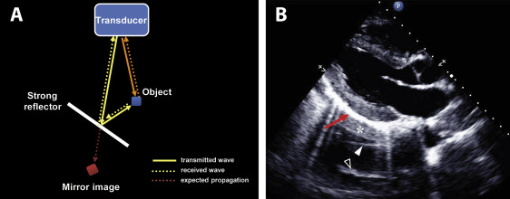
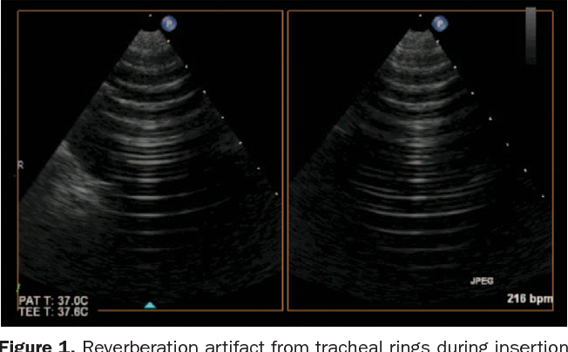
ECHOCARDIOGRAM Artifacts
Source:
https://www.asecho.org/wp-content/uploads/2021/01/2016_JASE_Bertrand_Fact-or-Artifact.pdf
https://www.semanticscholar.org/paper/Imaging-artifacts-during-transesophageal-Pamnani-Skubas/b9a8e62727eebe4b5cc4476dd8a74e99215ef516

Slide 8
Project objectives
Find an optimal student model for high performance on mobile devices
Keep >90% of Teacher performance
Memory size <50 MB
Inference Speed <0.5 sec (30 FPS)
Identify suitable student architectures
Transfer knowledge from the teacher to the student models

Slide 9
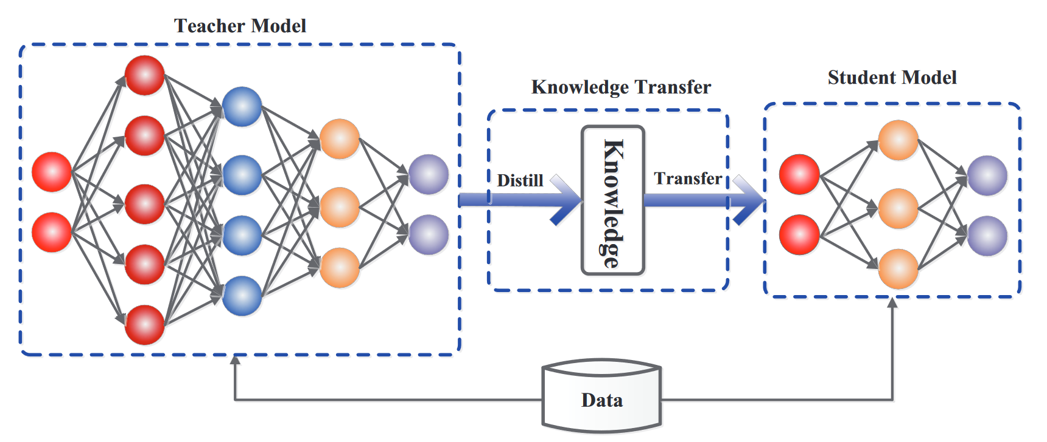
Basic framework for knowledge distillation
Source:
Gou, J., Yu, B., Maybank, S. J., & Tao, D. (2021). Knowledge distillation: A survey. International Journal of Computer Vision, 129, 1789-1819.

Slide 10
Knowledge distillation overview
Smaller model is supervised by a larger teacher model
Types of knowledge:
Response-based
Feature-based
Relation-based
Distillation algorithms:
Offline distillation (most common)
Online distillation
Self-distillation
Importance of the architecture of the teacher and student model in knowledge distillation

Slide 11

Prerequisites
Temperature-scaled softmax: $p\left(z_{i},T\right)=\frac{exp\left(z_{i}/T\right)}{\sum_{j}{exp\left(z_{j}/T\right)}}$
Distillation loss:
$$L_{D}\left(p\left(z_{t},T\right),p\left(z_{s},T\right)\right)=L_{KL}\left(p\left(z_{t},T\right),p\left(z_{s},T\right)\right)$$
Student Loss:
$$L_{S}=L_{CE}\left(y,p\left(z_{s},T=1\right)\right)$$

Slide 12
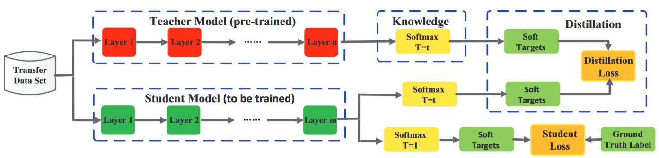
Methods
Focus on offline-based knowledge distillation
Three response-based techniques were identified for the task
Source:
Gou, J., Yu, B., Maybank, S. J., & Tao, D. (2021). Knowledge distillation: A survey. International Journal of Computer Vision, 129, 1789-1819.

Slide 13
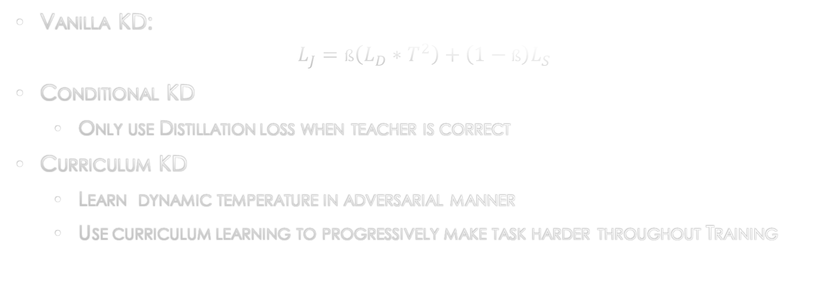
Methods
Vanilla KD:
$$L_{J}=ß\left(L_{D}∗T^{2}\right)+\left(1−ß\right)L_{S}$$
Conditional KD
Only use Distillation loss when teacher is correct
Curriculum KD
Learn dynamic temperature in adversarial manner
Use curriculum learning to progressively make task harder throughout Training

Slide 14
Experimental setup
Four different student architectures optimized for mobile devices
Mobilenet-V3-large/small
Shufflenet
Ghostnet
Metrics used for performance evaluation:
Validation accuracy
Validation F1-score
Metrics used for speed and size evaluation:
Inference and train speed
Size in megabytes

Slide 15

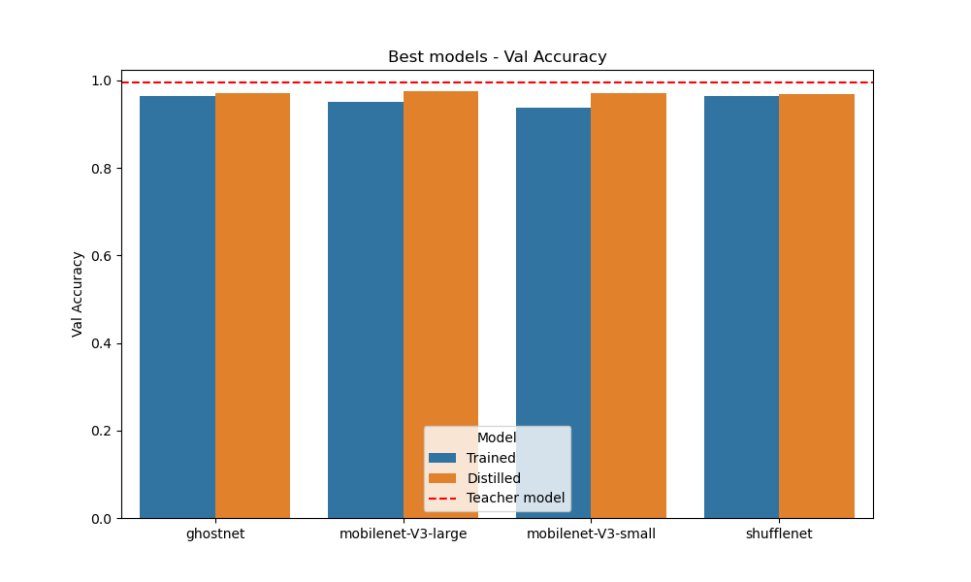
Validation accuracy of different student architectures

Slide 16
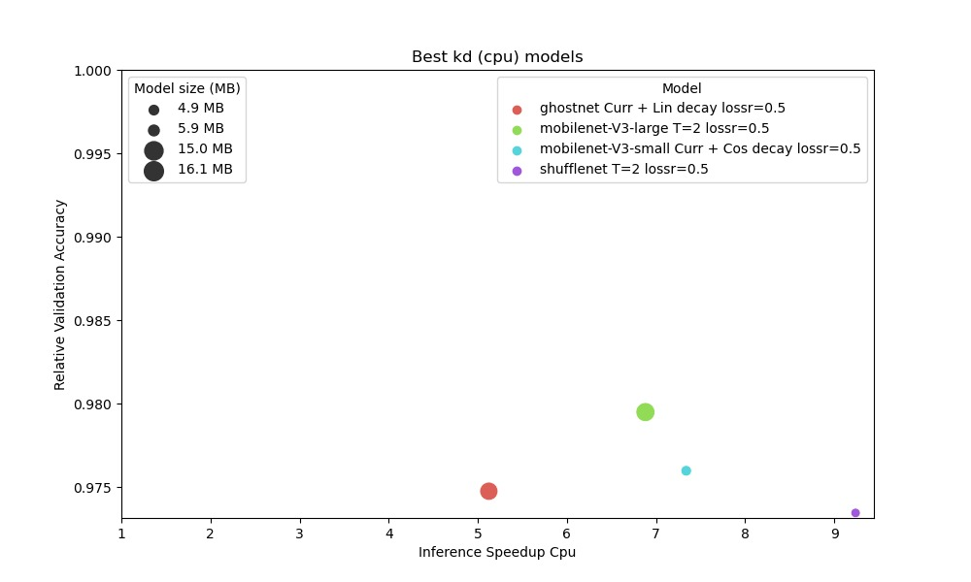
Results

Slide 17
Limitations
Restricted Hyperparameter search space
Lack of statistical significance testing
Results without KD are already very close to teacher model

Slide 18
Q&A

Slide 19
THANK YOU

Slide 20
